Slide 1


Put AI into Action & Boost Productivity with VAC & TAP
November 2023
Julien Kolaric
Frédéric Klein
Notes:
Hello everyone. My name is Frédéric KLEIN. I'm with my colleague Julien Kolaric. Today, we're going to explore the impact of AI in the business world and how our Tanzu solutions can be usefull in this journey.

Slide 2





Julien KOLARIC
Frédéric KLEIN
Solution Engineer
Tanzu Specialist
VAC TSL
Solution Engineer
Tanzu Specialist
AI Enthusiast
@fklein82 – blog.fklein.me
Notes:
Julien is an SE and he is the Tanzu subject Lead for VMware Tanzu Application Catalog. So don't hesitate to ask him, if you have some questions about the VAC product.
And Julien I'm very happy to do this presentation with you my friend.

Slide 3
Agenda
Introduction
DevOps vs MLOps
Demo with VAC
JupyterHUB
Kubeflow
Demo with TAP
Awesome AI Accelerator
Conclusion
Notes:
Before we dive into the details, let’s look at the agenda.
I will start with a brief introduction to set the stage.
Then I will explain the key differences and the unique value that MLOps brings.
Julien and I will do A hands-on demonstration of how the VMware Application Catalog can be use to deploy the MLOps tooling.
Then we will see Jupyter and Kubeflow in action.
I will showcase some cool apps using the model created on Jupyter and I will execute it on Tanzu Application Platform
And for the conclusion, We'll wrap up our session with key takeaways and open the floor for any questions you might have.

Slide 4


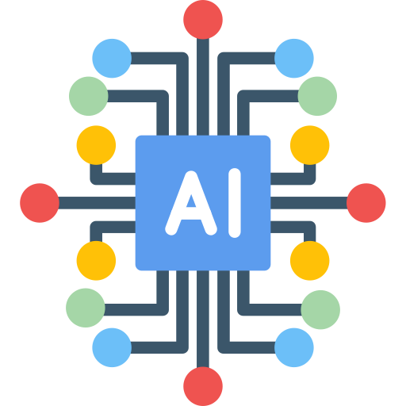


New World of Cloud AI & Analytics
Situation: Unprecedented volume/type of Data, on multiple Clouds, leveraged by mutliple user profiles, with exploding AI/ML usage
Explosion in Data Volume
64.2 zettabytes of data per year
New Data Types (mobile, social, IoT)
46 Billion connected devices
Data in the Multi Cloud, Hybrid
80% of organizations store data in multi-hybrid
Users
500 million Business data users
Machine Learning/AI
1 billon workers assisted by AI/ML
Notes:
Data and AI are rapidly expanding, and we're seeing incredible amounts of data - over 64.2 zettabytes a year. Imagine if each byte were a kilometer, it's enough to travel to the moon and back thousands of times.
We're also dealing with a variety of data from billions of connected devices, including phones and IoT devices, all generating information that we need to use wisely.
This data is everywhere, not just in one place. Most organizations use multiple clouds or a mix of environments to store it, which means we have to be smart about how we handle it.
With half a billion business data users globally, there's a huge range of needs and skills that we need to cater to.
And it's not just about storing this data - it's about using it for AI. AI and machine learning are already helping a billion workers.

Slide 5
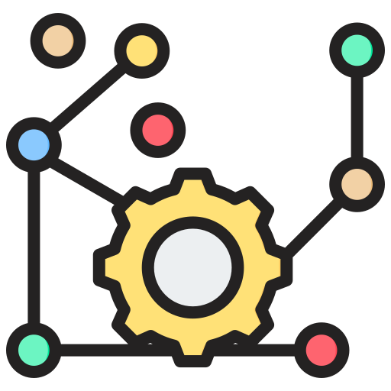
Data Management, AI, and Analytics Challenges
96%
72%
Ressource Contraints
96% of IT and engineering decision-makers say no-code/low-code will be a priority beaucause of the lack of Software Engineers
Complexity
72% of organizations are stil struggling to operationalize within their entreprise
Notes:
but, the path to AI implementation have some challenges.
Resource Constraints are critical. An 96% of IT and engineering leaders recognize no-code/low-code solutions as a priority. Why? Because there simply aren't enough software engineers to keep up with the demand for new applications.
But it's not just about having enough hands on the keyboard; it's also about the inherent complexity. 72% of organizations admit they're still grappling with how to operationalize AI within their enterprise.

Slide 6
Only 1% of AI/ML projects are successful
Notes:
This figure, 'Only 1% of AI/ML projects are successful,' isn't just a statistic—it's a challenge to the industry. It shows that success in AI and ML isn't just about technology; it's about strategy, support, and effective execution. And MLOPs approach can help the projects to join that 1% of success stories. It highlights the importance of choosing the right partners, the right strategy, and the right platform – one that is designed not just for the 1% but for the 99% as well.

Slide 7


MLOps Streamlines the development, Operationalization, and Execution of AI/ML Models
DevSecOps 👉 Tanzu Develop, Operate & Optimize pitch
Cost, Performance, Security
DEVELOP
OPERATE
OPTIMIZE
DevEx with Golden Paths
Application Runtime
Governance &
Continuous
Improvement
Notes:
As Tanzu SE, you're well aware of the 'DOO' framework. With TAP and the Golden Paths, we streamline the app journey from development to deployment, our TKO bundle ensures the customer apps perform optimally, and our tanzu intelligence portfolio keeps the customer on the path of continuous improvement.
It’s a about DevSecOps. But What about MLOps?

Slide 8
MLOps Streamlines the development, Operationalization, and Execution of AI/ML Models
MLOps 👉 covers all the phases of AI/ML
PREPARE
DATA
BUILD
MODEL
DEPLOY
CONSUME
AND MONITOR
Understanding the objectives and requierements of the project and preparing the data needed for the model.
Build and Assess various models based on a variaty of different modeling techniques
Operationalize and monitor the models to deliver business value and performance
Notes:
"MLOps stands at the forefront of AI and Machine Learning, streamlining the entire lifecycle of model development, operationalization, and execution. It's an essential practice that ensures efficiency and effectiveness in AI/ML projects."
Phase 1: Prepare Data
"The first step in the MLOps journey is Data Preparation. This is where we align our AI/ML project with the specific objectives and requirements of the business."
"In this phase, data is gathered, cleaned, and transformed. It’s all about understanding the nature of data, ensuring its quality, and preparing it in a way that it can effectively train our models."
Phase 2: Build Model
"Next, we enter the Build Model phase. This is where the magic happens!"
"We explore a variety of modeling techniques, assess their performance, and select the one that best meets our project goals. This phase is about experimentation, model tuning, and validation, ensuring our model is robust and accurate."
Phase 3: Deploy, Consume, and Monitor
"The final phase is where we bring our model into the real world. Deployment is not just about putting a model into production. It's about integrating it in a way that it can deliver real business value."
"Once deployed, it's crucial to continuously monitor the model. This includes tracking its performance, managing updates, and ensuring it adapts over time to maintain its accuracy and effectiveness."
Conclusion
"In summary, MLOps is not just a methodology; it’s a journey that covers every aspect of an AI/ML project. From preparing data to building and deploying models, MLOps ensures that our AI initiatives are successful, scalable, and sustainable."

Slide 9
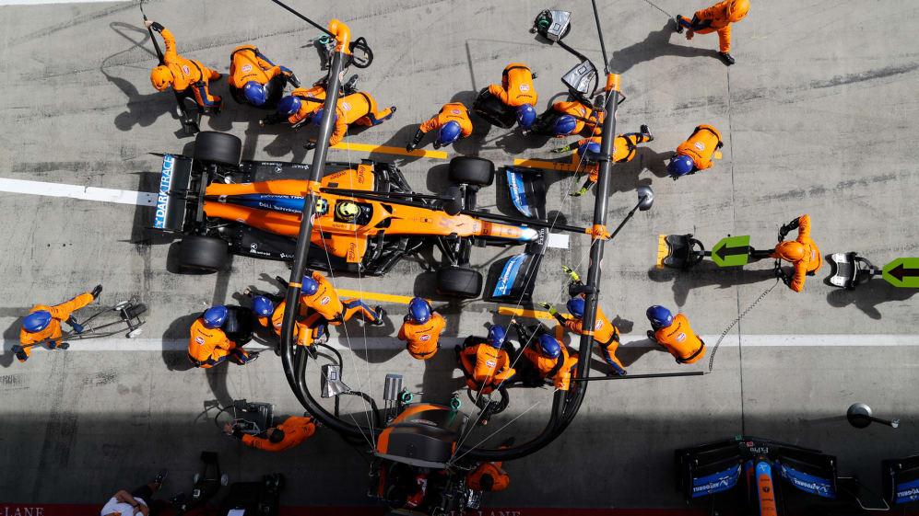
MLOps is a Team Sport
Notes:
MLOps isn't just about technology; it's a team sport.

Slide 10
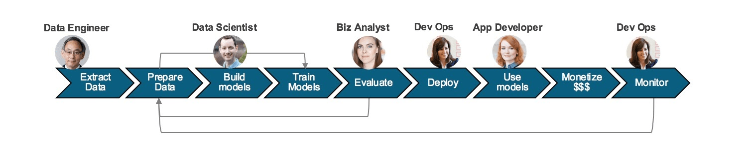
Cross-funtional collaboration is key
Jupyter HUB
MLFlow
Python
Accelerator
Deployed with VAC
TAP
Kubernetes
Notes:
It requires close collaboration across functions. Just like in any team sport, MLOps thrives on the synergy of its team members. Each member plays a vital role in turning data into actionable insights and value."
"Data Engineers set the stage with solid data foundations. Data Scientists then craft the predictive models. Business Analysts align these models with market needs. App Developers integrate these models into applications, and DevOps ensure these applications run smoothly."
"Together, they ensure that MLOps is more than just model development; it's about delivering comprehensive solutions that drive business forward."
"In our MLOps demo, Data Scientists work with Jupyter Hub to craft and train models, while MLFlow manage the lifecycle of our models, and deploy it to production"
"Application Developers use the TAP accelerator to quickly bring these models into apps that our customers use."
"I'll play the role of Data Scientist, Julien the role of Platform Engineer, and we will show you from start to finish how we can bring a model to life and into use

Slide 11

Demo

Slide 12
Ressources
MLOps demo with VAC and TAP
https://github.com/fklein82/awesome-ai-demo-with-vac-tap
Image Classification Python Accelerator for TAP
https://github.com/fklein82/awesome-ai-python-function
AI Recognition Accelerator with Node.js
https://github.com/fklein82/awesome-ai-video-recognition#ai-recognition-accelerator-with-nodejs-and-ml5js
Text Analysis Accelerator with Node.js
https://github.com/fklein82/awesome-ai-text-sentiment-analysis
Notes:
"As we wrap up, I'd like to leave you with some resources that can further enhance your understanding and application of the concepts and tools we've discussed today.
First, we have the source code for the MLOps demo with VAC and TAP we did..
Next, we have the Image Classification Python Accelerator for TAP. This resource is excellent for those interested in deep diving into image classification using Python in the TAP environment.
Then we have the video recognition based on Node.js Accelerator.
Lastly, we have the Text Analysis Accelerator with Node.js.
All these resources are designed to provide you with hands-on experience and deeper insights into the power of AI and MLOps.

Slide 13
Thank You “We’ve had a lot of fun”
Notes:
Thank you all for your time and attention today. It's been a pleasure discussing these exciting developments in AI and MLOps with you. For any further inquiries or a deeper discussion, please don't hesitate to reach out to us

